Slide 1
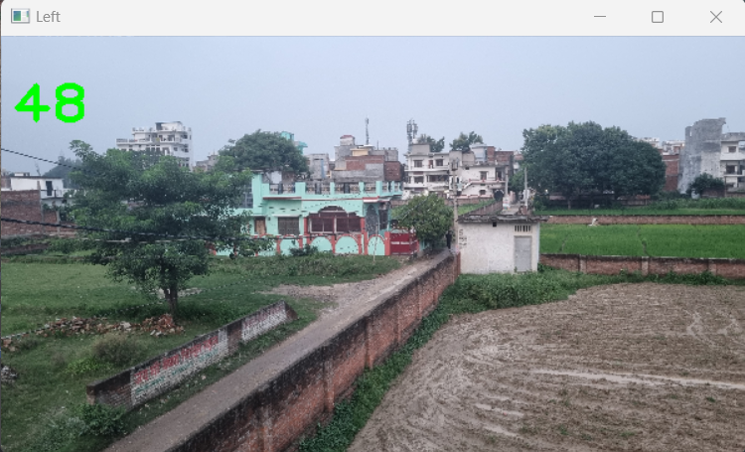

Slide 2
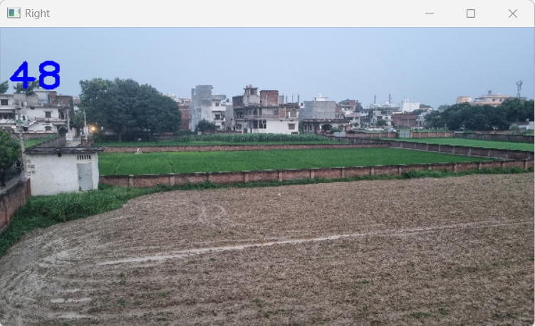

Slide 3
Step 1: Capturing Images at 1/60 Second Intervals
Imagine a scenario where a camera is set to capture images at an incredibly
fast rate of 1/60 seconds per frame. This means that the camera is taking 60
images in a single second, each snapshot freezing a moment in time with
utmost precision. This rapid succession of images allows the camera to capture
even the most fleeting movements. Here image 1 and 2 are the example of that image.

Slide 4
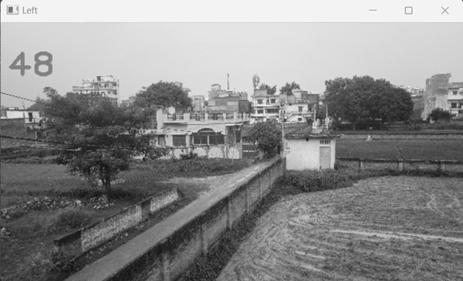
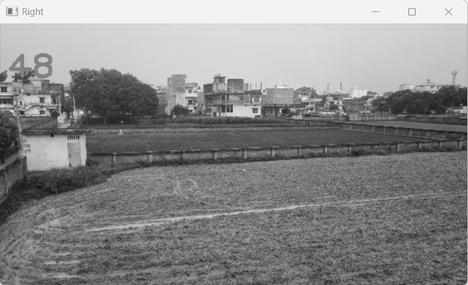

Slide 5
Step 2: The Art of Image Stitching
Once the images have been captured, the real magic happens during
the stitching process. Image stitching is a technique that involves combining
multiple images into a single panoramic or composite image. In our case,
we are combining images captured at 1/60 second intervals, resulting in a fluid
representation of time passing.
Step 3: Creating a Seamless Narrative
The process begins with selecting a reference point in the first image.
As subsequent images are captured, the software analyzes overlapping regions
and aligns them to the reference point. Each image contributes to the final composite,
and the result is a captivating visual story that seamlessly illustrates the progression of time.

Slide 6
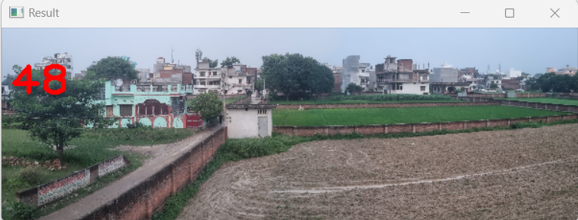

Slide 7
Step 4: Showcasing the Final Composite
The final composite image is a testament to the camera's ability
to capture an incredible level of detail and movement. The stitched image
provides viewers with a unique perspective, as if time has been condensed into
a single frame. It's a testament to both the technological prowess of modern
cameras and the creativity of photographers who harness these capabilities.
Final The process of stitching images captured at 1/60 second intervals comes together
seamlessly, resulting in a captivating visual stream where each frame flows in real-time
without any latency or delay. As the images are rapidly captured and meticulously
stitched, the composite image evolves naturally, creating an uninterrupted narrative
that beautifully encapsulates the passage of time, movements, and moments, all
unfolding fluidly and instantly to the viewer's eye.

Slide 8




Footage of Cam 1
Footage of Cam 2
Creation of Seamless Narrative
Showcasing the Final Composite

